Slide 1
Quiz App Android
Members:
Shiva Kumar - 17STUCHH010062
Shaga Sresthaa – 17STUCHH010068
Pavan Teja – 17STUCHH010061
Mithun Reddy – 17STUCHH010236

Slide 2
Introduction
This is a simple quiz application hic contains questions in multiple choice format.
This implements realtime database and authentication features.
It also has a user friendly ui and interface.
It also has several authentication features.

Slide 3
Authentication and Database
This uses Firebase as the database client
It provides various features like Authentication, Realtime Database, Storage, etc
User can have two options either to login if already has an email account or register for one.
It also prevents mail spamming by using email verification.

Slide 4
Features
It has all basic features like any other online application.
It also implements user database and the user can access all his data used on his profile page.
It is also secure as it uses many security features given by java.

Slide 5
Project Structure
Account Info
Login
Profile
Quiz
Register
Logout

Slide 6
Java Implementations Used
This application uses many features for its functionality.
It uses concepts of package and interface extensively.
App uses XML code for its design and Java for its main functionality.
It also uses concepts of method overloading, constructor overloading, Views in android, etc

Slide 7
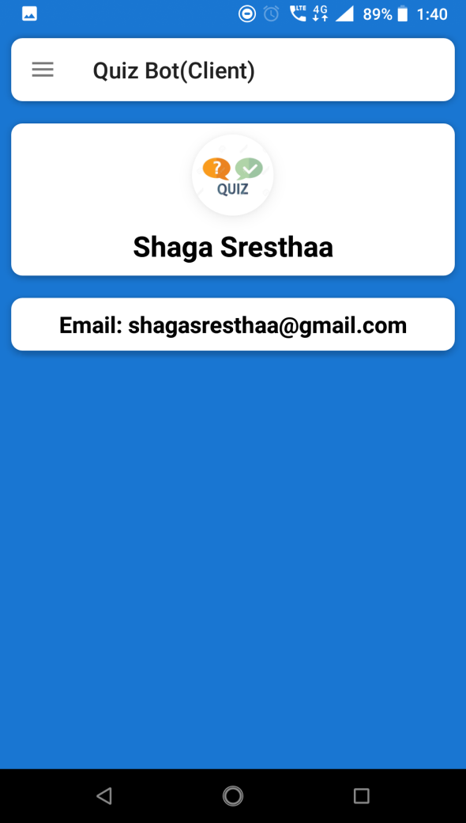
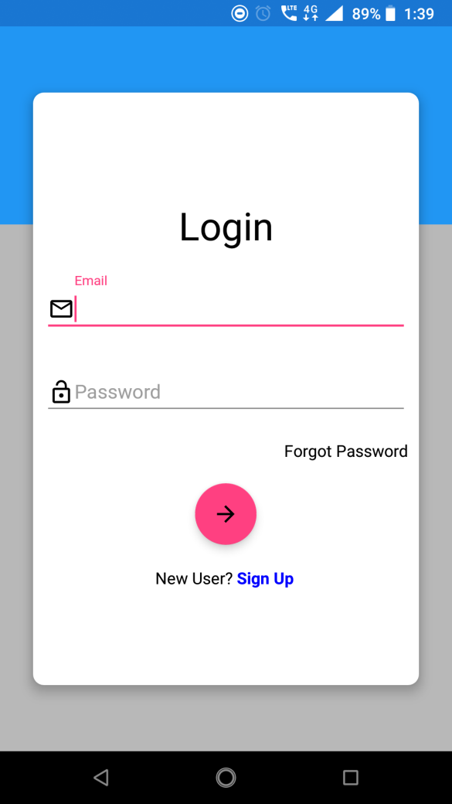
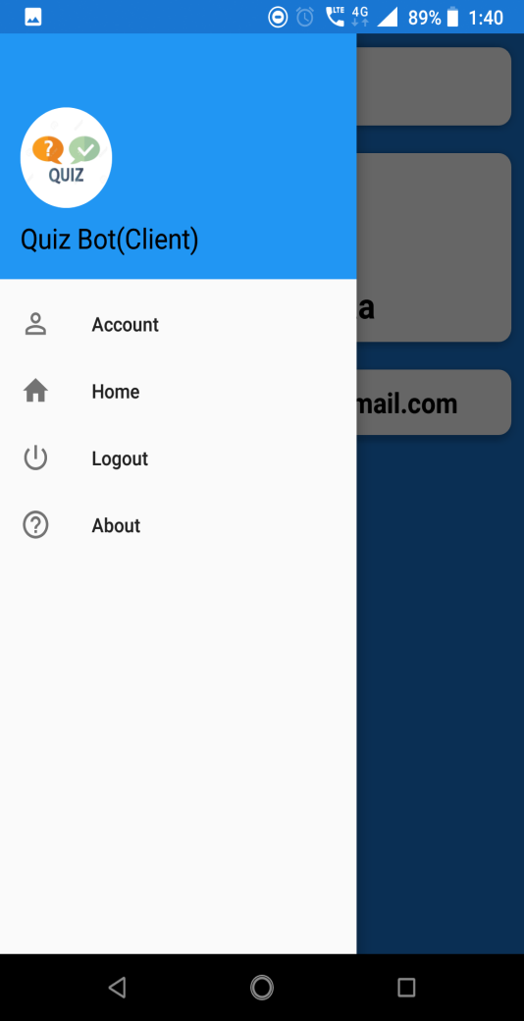
App Sample Shots

Slide 8
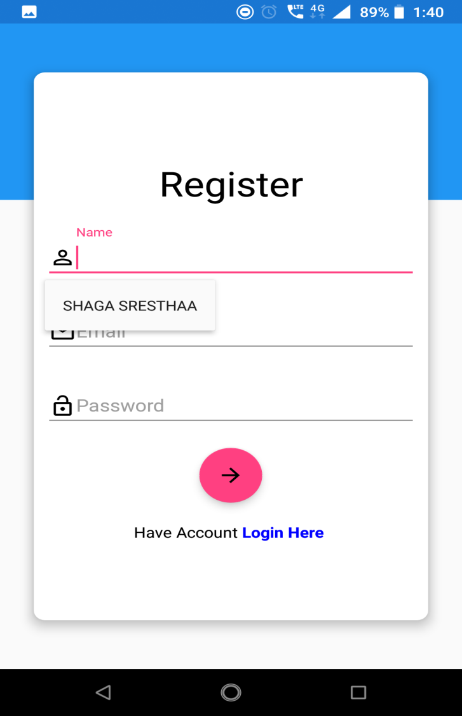
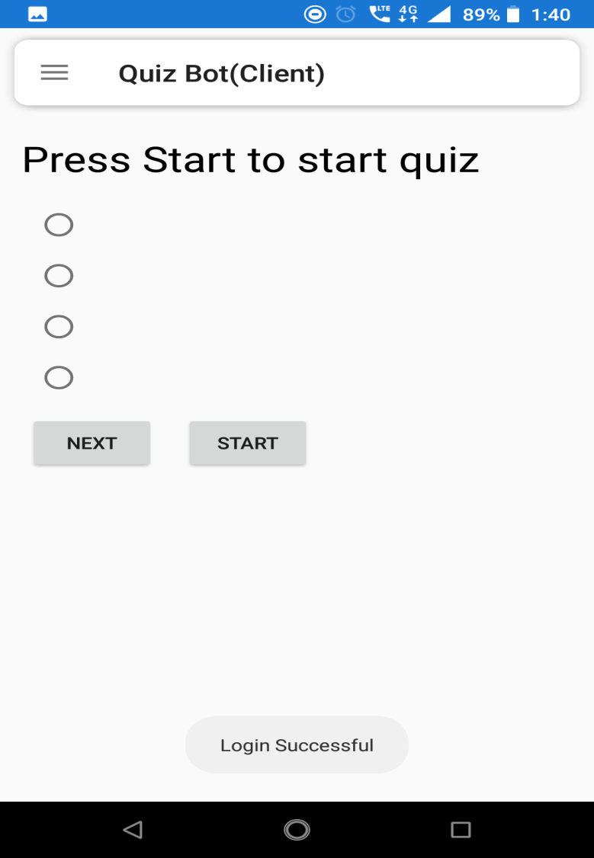
App Sample Shots

